Slide 1
IOT (Internet of Things)
What is IOT ?
The IOT is the network of physical objects—“things”—that are embedded with sensors, software, and other technologies for connecting and exchanging data with other devices and systems over the internet.

Slide 2
IOT is developed/coined by Kevin Ashton .
IOT means:
Sensor
Calculate
Data sending & receiving

Slide 3
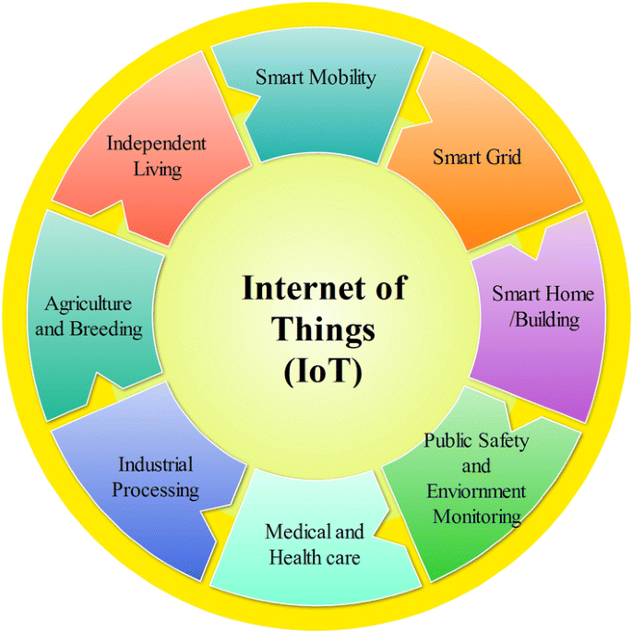

Slide 4
Working of IOT
Sense server/cloud analysis
Sense:-- data sensed by sensors.
server/cloud:--- data stored on server/cloud.
Analysis:--- here analysis data for use.

Slide 5
Advantages & Disadvantages of IOT
Advantages
Speed
Automation
Save time
Monitor
Better life style
Business opportunity
Easy access
Communication(M2M)
Cost reduction
Disadvantages
Security & Privacy
Complexity
Safety
Compatibility
Less jobs
Dependency
Laziness

Slide 6
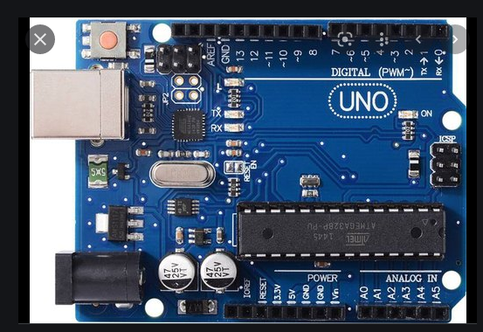
Ardino uno board

Slide 7
Communication modals

Slide 8
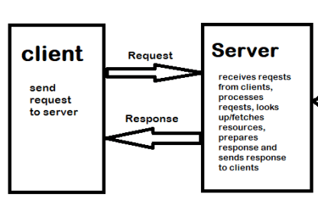
REQUEST-RESPONSE
COMMUNICATION MODAL

Slide 9
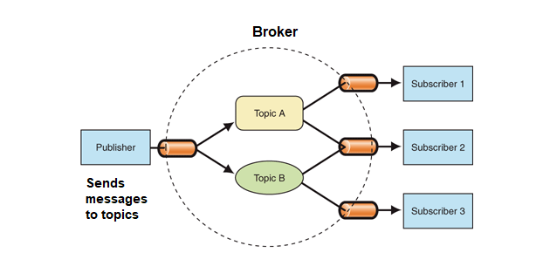
PUBLISH-SUBSCRIBE COMMUNICATION MODAL

Slide 10
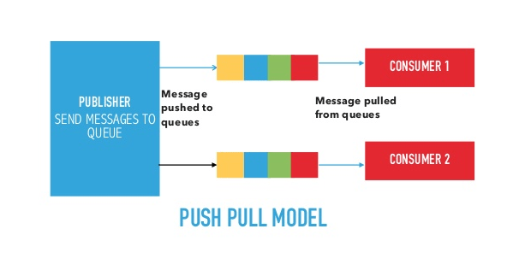

Slide 11
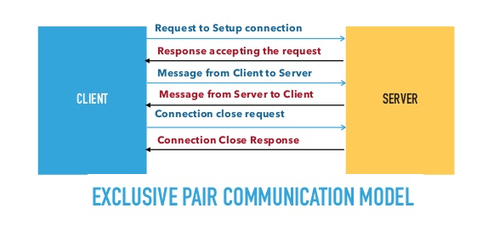

Slide 12
OSI MODAL

Slide 13
OSI MODAL
OSI stands for Open Systems Interconnection Modal is developed in 1984 by International
Organization for Standardization.
It is a reference modal( fully bookish modal)
It is not used in practical.
But some of features is used in practical modals like TCP/IP.
It has seven layers.

Slide 14
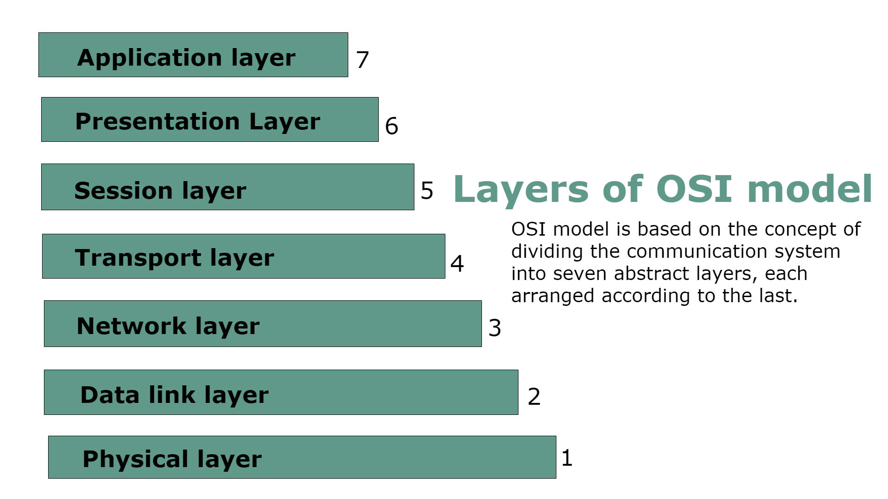
LAYERS OF OSI

Slide 15
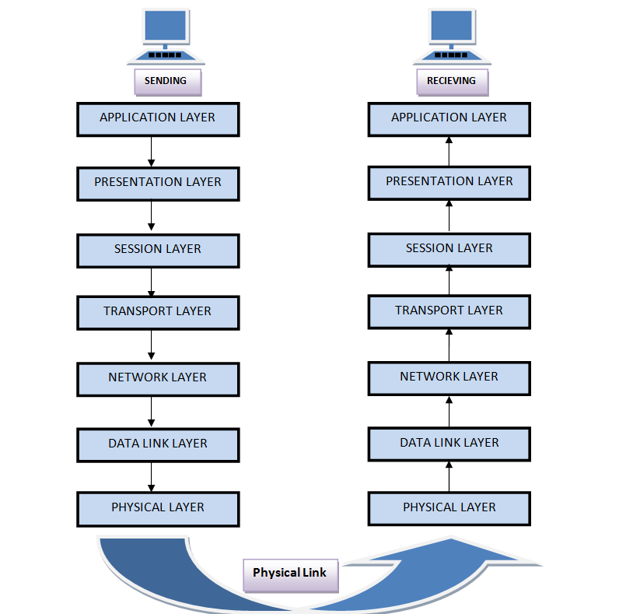

Slide 16
PHYSICAL LAYER
All things are touchable.
These all devices are purely hardware.
These works on physical layer.
These devices has not sense.
Physical layer has massage in bits form
It convert it in to signals and send to another devices .
These signals is in the form of electric signal in a copper wire ,light signal in optical fiber.

Slide 17
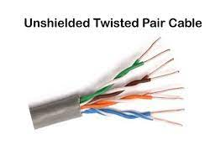
CABLES
PHYSICAL LAYER DEVICES

Slide 18
Twisted pair cable
Two twisted copper wires for less electromagnetic interference in communication.
Low frequency transmission.
Limited Distance transmission.
10 base T:- 10 for 10mbps at 100m
100 base T:-100 for 100mbps at 100m
Mbps(megabyte per second)
Cables has attenuation (signal weak /low)after all 100 meter so we have to set a repeater with it with working well. Repeater regenerate the signals and retransmit it.

Slide 19
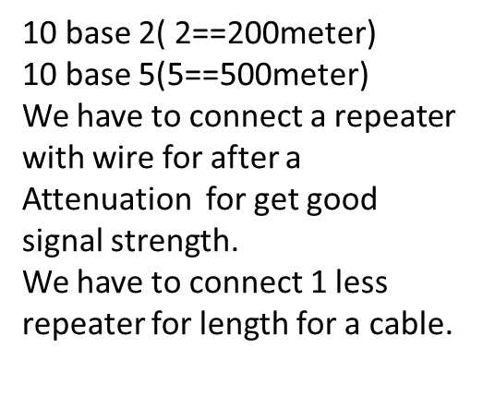
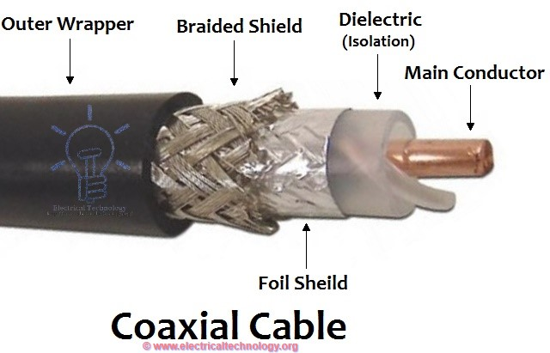
CABLES

Slide 20
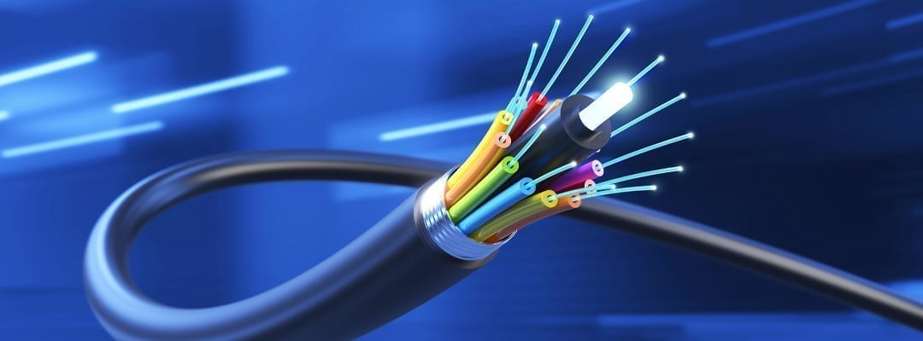
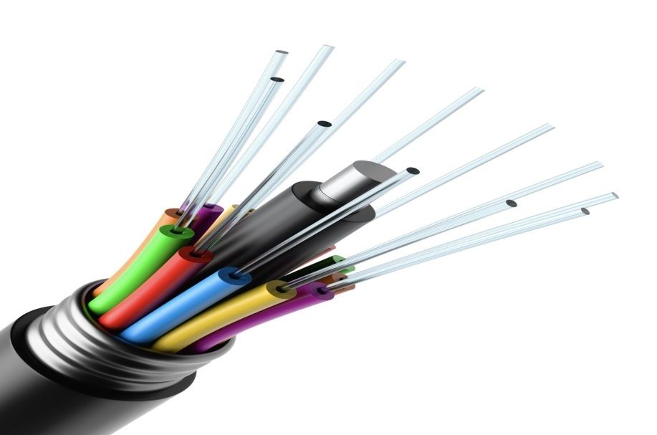
FIBER OPTIC CABLE
This cable transmit data with the speed of light.
100basefx=1.9 kilometer approx 2.0 km
It is used for highest speed data transmission.

Slide 21
Bandwidth
Broadband
The maximum amount of data transmitted over an internet connection in a given amount of time.
It is for wired communication.
Single connection at a time.
Broadband is the transmission of wide bandwidth data over a high speed internet connection.
It is for wireless communication.
Multiple connection at a time.

Slide 22
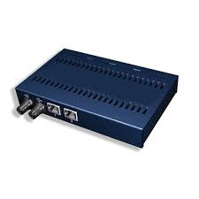
REPEATER
Repeaters are network devices operating at physical layer of the OSI model that regenerate an incoming signal before retransmitting it. They are incorporated in networks to expand its coverage area. They are also known as signal boosters

Slide 23
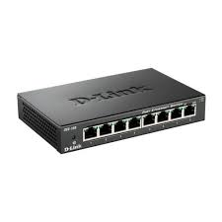
HUB
A hub is a physical layer networking device which is used to connect multiple devices in a network. They are generally used to connect computers in a LAN.
A hub has many ports in it. A computer which intends to be connected to the network is plugged in to one of these ports. When a data frame arrives at a port, it is broadcast to every other port, without considering whether it is destined for a particular destination or not.

Slide 24
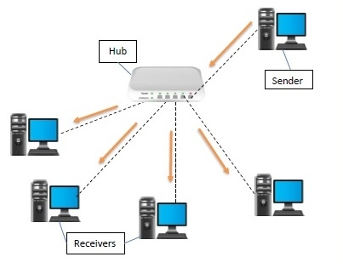

Slide 25
TOPOLOGY
Question:------- BUS RING STAR MESH HYBRID
No of cable
No of ports
Reliable
Security
Cost
Extra question:--- CABLE REPEATER HUB
Forward data
filter
collision

Slide 26
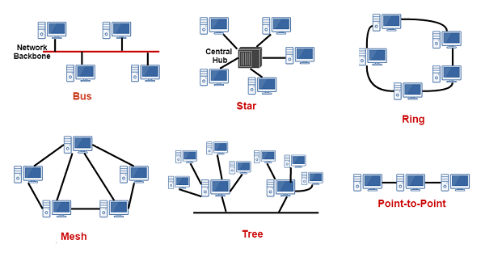

Slide 27
question | bus | Ring | Star | mesh
No of ports
No of cable
Reliable
Security
Cost

Slide 28
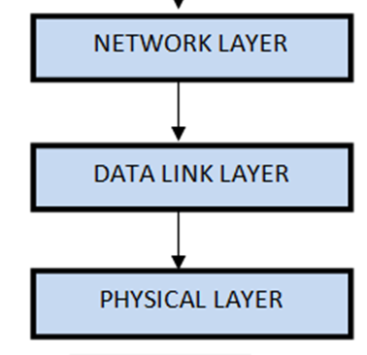
Data link layer

